Slide 1

Windows PowerShell
System administration and automation in a Windows environment
- Scripting -
Karin De Maertelaere, Jochen Mariën

Slide 2
Scripting
So what have we been doing until now?
Writing commands, not writing scripts
You can extend PowerShell, and use it as a ‘real’ programming language
Try to stop before going too far
You can tune your scripts to be easily useable by coworkers

Slide 3
Contents
What is in scripts (that wasn’t in cmdlets)?
Variables and types
Numbers
Strings
Date time
References
Arrays and hashes
Operators
Control Structures
Debugging

Slide 4
Contents
How do we write scripts?
Variable scopes
Running scripts
Catching errors
Parameters
Requires
Get-Computersystem demo

Slide 5
Comment
# comment
<# A block of comments, you can type continuously. Special characters ( #, $, {, }, &,<,>, …) may be included. #>

Slide 6
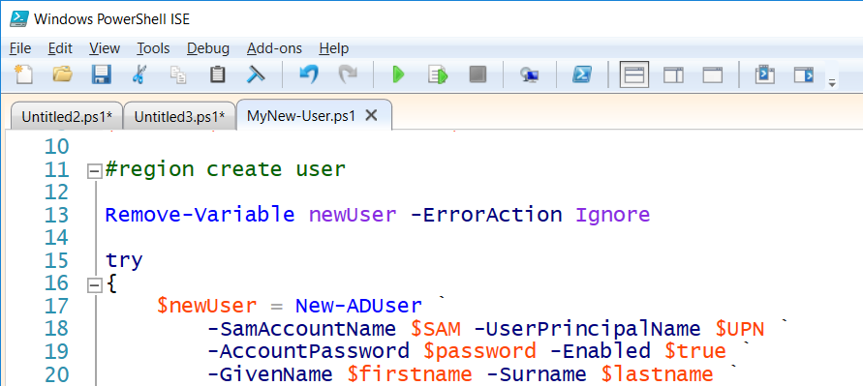
Region
A region is a part of the script that belongs together
Putting it in a region makes it possible to “click it together” in the ISE
Regions have no effect on the code execution
#region create user
Remove-Variable...
#endregion
Notes:
https://blogs.technet.microsoft.com/heyscriptingguy/2015/11/12/use-regions-in-powershell-ise-2/

Slide 7
Newlines
There are two ways to have a command-string continue on the next line
Backtick
Piping
Backtick: ` (AltGr + µ)
To separate parameters
Piping: | (AltGr + &)
When cmdlets are piped together, you can start a newline with every | without the backtick
New-ADUser `
-name "Morgan Freeman" `
-Path $location `
-samAccountName "Morgan.Freeman" `
-AccountPassword $password `
-PasswordNeverExpires $true `
-Enabled $true

Slide 8
Variables
$variableName
Consist of letters, numbers and _
Implicit declaration by assigning a value
Data: all types of data, including objects
Type: may but does not need to be explicitly defined
.Net class names and type names
[System.int32] (.Net)
[int] (PS) (type accelerator)
[int32] (shortcut for the .NET class type)
Type in front: [int] $a, will accept only data of that type

Slide 9
Variable types
$a = 5 # a will become the most suitable datatype
$a = [int] 5 # a will become an integer
$a = [int] 5.6 # a will become 6
Variables can change type…
When using the DateTime-type: use internal datenotation!
$a = 5
$a.GetType() # Int32
$a = 5.6
$a.GetType() # Double
$d = [System.DateTime] "12.04.1997"

Slide 10
Type accelerators
So is it [datetime] or [System.DateTime]?
It’s [System.DateTime], but [datetime] is a type accelerator
Type accelerators: shorter names for existing classes
[int] in stead of [System.Int32] (and not [System.Int64])
An overview:
function get-typeaccelerator {
# reference the accelerators
$acceleratorsType = [psobject].assembly.gettype("System.Management.Automation.TypeAccelerators")::Get
# return all built-in accelerators (property)
$acceleratorstype.GetEnumerator()
}
get-typeaccelerator

Slide 11
Strict mode
Forces you to declare variables
Doesn’t check:
Whether the codes works in PS2.0
That you don’t change the type of a variable
That the field you select in a table exists in the object
Corresponds with “Set-PSDebug”
Write-Host $noVar # no problem
Set-StrictMode -Version latest
Write-Host $noVar # error

Slide 12
Clearing and removing
Clearing a variable makes it empty
Removing a variable destroys it
But even after removing it, you can read the value
Unless you are using strict mode
Clear-Variable a
Get-Variable a
Remove-Variable a
Get-Variable a

Slide 13
Predefined variables
$true and $false
$args
An array containing the arguments to the script/function
$Error
Contains all errors in this session
$HOME, $PROFILE, $PSHOME, $Host, $PSVersionTable , …
Get-Variable for the others

Slide 14
Constants
A variable that can’t be changed
Nice for values that you want to define once, and reuse
$tempFolder, $domainName
Created with “Set-Variable”
Set-Variable MyConstant "ok" –Option readonly
$MyConstant
$MyConstant = "nok"
Remove-Variable MyConstant -Force

Slide 15
Automatic resolving
From “$variable” to “content of var”
Only works between double quotes
Not between single quotes
Not when it’s backticked ( ` )
Works anywhere you can use strings
As parameters…
$a = 1
Write-Host "The content of `$a is $a."
# In the parameter of a cmdlet
$proc = "powershell*"
Get-Process -Name $proc

Slide 16
Automatic resolving
Watch out with arrays…
Will return a list of all servicesnames, and “[0].name” in the end of it
Works!
Also:
$services = Get-Service
Write-Host "First servicename: $services[0].name"
Write-Host "First servicename: $($services[0].name)"
Write-Host ("First servicename: " + $services[0].name)
Notes:
Write-Host "First servicename:" $services[0].name

Slide 17
Datatypes
You can have the type be determined automatically
Or you can set it manually
This will stop the type from changing:
$i = 5368888888888888
[Int64] $i = 5

Slide 18
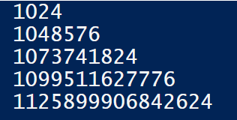
Predefined: Sizes
1KB
1MB
1GB
1TB
1PB
(Get-Disk).size / 1GB

Slide 19
Strings
Other languages have string-functions:
Substring($string, 3,5) cuts a part out of a string
In PS, these functions are methods of the string-objects:
" " | Get-Member -MemberType method
CompareTo | PadLeft | Substring
Contains | PadRight | ToLower
EndsWith | Remove | ToUpper
Equals | Replace | Trim
IndexOf | Split | TrimEnd
Insert | StartsWith | TrimStart

Slide 20
String manipulation
$a = "A piece of text."
# Functions
$a.ToUpper()
$a.PadLeft(50)
$a.Trim()
$a.Trim("A","."," ")
# comparing
$a.Contains("piece")
$a.CompareTo("B piece of text.")
$a.CompareTo("0 piece of text.")
$a.Trim(".").ToUpper().EndsWith("TEXT")

Slide 21
String manipulation
What’s in it for me?
A good point, editing strings is a programming-thing, not a scripting-thing
But:
Import-Csv $csvfile -Delimiter ';' -Encoding UTF7 |
foreach-object { new-aduser -Path $pathInAD `
-SamAccountName $_.first.replace(' ','.') `
-UserPrincipalName $_.first.replace(' ','.') `
-DisplayName ($_.first + " " + $_.last) `
...

Slide 22
Strings: Static vs instance
Static methods
A method on the class
Use “[name class]::” when calling
Instance method
A method on an instance of the class
Use “$varname.” when calling
" " | Get-Member -Static -MemberType method
" " | Get-Member -MemberType method

Slide 23
Strings: Static vs instance
The instance methods are usually somewhat more logical
Sometimes an instance method doesn’t exist
[String]::Join
Everything from [Math] is usually used static
# the static way
if([STRING]::Equals("b","b"))
{ Write-Host "Equal" }
else
{ Write-Host "Not equal" }
$var = "b"
# the instance way
if($var.Equals("b"))
{ Write-Host "Equal" }
else
{ Write-Host "Not equal" }

Slide 24
DateTime
.NET class System.DateTime: Get-Date
Change date/time: Set-Date
For remote computers: Get-WMIObject Win32_CurrentTime
Take care of using the right culture at the right moment

Slide 25
# Limit output to ...
Get-Date –displayhint date
Get-Date –displayhint time
# create a date
Get-Date "04/12/1997 23:00:00" # choose a date
Get-Date # now
(Get-Date).AddDays(-1) # now, one day ago
(Get-Date).Date.AddDays(-1) # yesterday
[system.datetime]"12.04.1997" # internal culture!
# 3 ways to substract dates
(Get-Date).Subtract((Get-Date “04/12/1997 23:00:00”))
(Get-Date) – (Get-Date “04/12/1997 23:00:00”)
New-TimeSpan -end (Get-Date) -start (Get-Date “04/12/1997 23:00:00”)
Get-Culture
(Get-Culture).DateTimeFormat
# Random...
Get-WMIObject Win32_CurrentTime –Computername “.”
Set-Date “1/1/2000 00:00:00” -whatif

Slide 26
References
Have a variable that is a reference to another variable
Always alter the reference through “.value”!
Otherwise you ‘break’ the reference
Mostly used as parameters for functions
$greeting = "hello"
$refToGreeting = [ref]$greeting
$refToGreeting
$refToGreeting.value = "Good day"
$greeting
$refToGreeting.GetType().FullName
# System. … .PSReference
$refToGreeting = "Good day"
$refToGreeting.GetType().FullName
# System.String

Slide 27
Reference parameters
function referencetest([ref]$cup, [ref]$plate)
{
$cup.Value = "coffee"
$plate.Value = "muffin"
return "Ready!"
}
$myCup = "empty"
$myPlate = "empty"
referencetest -cup ([ref]$myCup) -plate ([ref]$myPlate)
"In my cup: " + $myCup
"On my plate: " + $myPlate

Slide 28
Arrays
Any sequence of comma separated values is an array
Datatypes don’t need to be the same (but should)
You can also explicitly create an array…
And look at all the methods and properties of the array-class
$array = "one", "two", "three"
$array = 1, "two", (1/3)
$array = @(1, "two", (1/3))
$array | Get-Member # shows meths and props of elements in array
Get-Member -InputObject $array # shows meths and props of array

Slide 29
Arrays
Strongly typed array
Multi-dimensional array
Adding values
[int[]] $array = 1,2,3,(10/3),"5"
$array = @( (1,2,3),("four","five","six"),7)
$array[0] # 1, 2 and 3 (seperate lines)
$array[1][2] # six
$array[2] # 7, but very bad programming
$array = 1,2,3 # 1,2,3
$array += 4 # 1,2,3,4
$array[4] = 5 # Next index: error
$array[7] = 6 # Skipping indexes: error
$array.Add(6) # error

Slide 30
Wait, what?
Creating an implicit array will create an array
Using methods such as “Add” and “RemoveAt” require an ArrayList
In programming, this is a big difference, especially towards memory allocation
Then of course, in programming “+=” wouldn’t work on an array
The reason it does work in PS, is that PS creates a new array based on the previous array and the added value
This can become slow
$array.GetType().FullName # -> System.Object[]

Slide 31
Practical example
Add a value to the path-variable
Works, but can be slow
If the array is too large, which it will never be
Alternative
Or…
$pathArray = $env:Path.Split(";")
$pathArray += "c:\myFolder"
[String]::Join(";",$pathArray)
$pathList = [System.Collections.ArrayList] $env:Path.Split(";")
$pathList.Add("C:\myfolder")
[String]::Join(";",$pathList.ToArray())
$env:Path += ";c:\myFolder"

Slide 32
Hash tables
Arrays, but with strings as indexes
Why? Easier to fetch values
Practical use: make nicer tables
$Town = @{ Mol=”2000”;Balen=“2490”;Kasterlee=”2460”;}
$Town.Mol # -> 2000
$Town.Mol = 2400
$a = @{Expression={$_.Name};Label="Process Name";width=25}, `
@{Expression={$_.ID};Label="Process ID";width=15}, `
@{Expression={$_.MainWindowTitle};Label="Window Title";width=40}
Get-Process | Format-Table $a

Slide 33
Operators
Arithmetic operators
+, *, -, /, %
Equality operators
=, +=, -=, *=, /=, %=, ++, --
Comparison operators
-eq, -ne, -gt, -ge, -lt, -le, -in, -notin, …
-contains, -notcontains, -in, -like, -notlike
Using wildcards (*, ? , [x-y], [xy])
-match, -cmatch, -imatch, -notmatch
Using regular expressions
Logical and bit operators
-and, -or, -xor, -not, -band, -bor, -bxor, -bnot

Slide 34
Nicities
$x=8
$y=1
$x,$y = $y,$x
"X $x and Y $y after an elegant switch"
$String = “*=”
$LongString = $String*20
"$LongString"
" nr of characters: " + $LongString.length
$a=1,2,3,4,5
$b=$a*3
"192.168.14.12" -replace "14", "15"
$array = "Archimedes", "Aristoteles", "Plato", "Euler"
$array -contains "Plato"
"Plato" -in $array
"A cmdlet more or less" -like "*cmdlet*"
$What = “Process”
&("Get-$What") # call operator
Invoke-Expression ("Get-$What")

Slide 35
Type operators
1000/3 -as [int] # -> 333
1000/3 -is [int] # -> false
(Get-Date) -is [datetime] # true
"23/02/2015" -is [datetime] # false
(Get-Date "23/02/2015") -is [datetime] # true

Slide 36
Control structures
The two you’ll use
If {} elseif {} else {}
Foreach($var in $collection)
The others
Switch ($var) { value { … } value { … } default { … } }
While (condition) { … }
Do { …} while (condition)
Do { …} until (condition)
For ($i = 1; $i -le 10;$i++) {…}

Slide 37
IF
Sometimes an if can be replaced by a switch
The switch in PowerShell is more powerful than in C#...
If ($i –lt 10)
{ “Smaller than 10” }
Elseif ($i -lt 50)
{"Smaller than 50"}
Elseif ($i -lt 100)
{"Smaller than 100"}
Else
{“Larger than or equal to 100”}

Slide 38
Switch
$i=22
Switch ($i)
{
1 {“one”}
5 {“five”}
10 {“ten”}
default {“something else”}
}
$fruit = "date"
switch -wildcard ($fruit)
{
"a*" {"An apple"}
"b*" {"A banana"}
"d*" {"A date"}
“c*" {"Cherries"}
“f*" {"A fig"}
default {“Strange type of fruit"}
}
$symbol = "?"
switch -wildcard ($symbol)
{
"[a-z]" {"A letter"}
"[0-9]" {"A number"}
"[,;:.!?]" {"A punctuation mark"}
default {"Unknown symbol"}
}
$sentence = "Microsoft Windows PowerShell"
switch -regex ($sentence)
{
"^\w+$" {“One word"}
"^\w+ \w+$" {"Two words"}
"^\w+ \w+ \w+$" {"Three words"}
default {"A lot of words"}
}

Slide 39
Foreach
$procs = Get-Process
foreach($proc in $procs)
{
$proc.ProcessName.ToUpper()
}
Can be a loop:
+ Easier to read
+ Can easily contain more functionality
- More typing
- Requires variables
And a cmdlet:
+ More PowerShell-y
+ Doesn’t require variables
- Difficult to add more functionality
- Kills the pipe
Get-Process |
ForEach-Object { $_.ProcessName.ToUpper() }

Slide 40
Other loops
For ($i=1;$i –lt 10; $i++) {$i}
(1..9)
Do
{
$i = Get-Random -Minimum 1 -Maximum 10
Write-Host $i
} until ($i -eq 4)
$i=0
While ($i –lt 15)
{
$i = Get-Random -Minimum 1 -Maximum 20
Write-Host $i
}
Do
{
$i = Get-Random -Minimum 1 -Maximum 20
Write-Host $i
} while ($i -le 15)

Slide 41
Debugging
When creating a script you sometimes want to “see what is going on”
In that case, use “Write-Debug”
The output of “Write-Debug” depends on the setting of $DebugPreference
Continue: PowerShell will show the debug message
Inquire: PowerShell will prompt the user
SilentlyContinue: PowerShell will not show the message
Stop: PowerShell will show the message and then halt
Ignore and Suspend: Not supported for an actionpreference variable
Advantage: you can leave the debugging in the script, even after you deploy it
Similarly: Write-Verbose
(The six year old that just won’t stop talking)

Slide 42
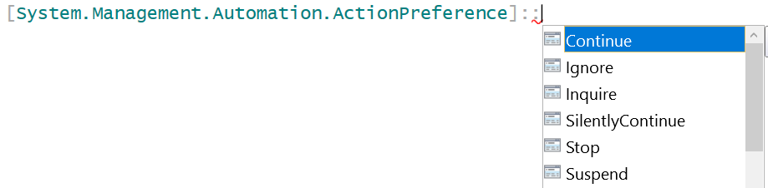
Write-Debug/Verbose
using namespace System.Management.Automation
$DebugPreference = [ActionPreference]::Continue
Write-Debug "Not completed"
$DebugPreference = [ActionPreference]::stop
Write-Debug "Not completed"
$DebugPreference = [ActionPreference]::Inquire
Write-Debug "Not completed"
$DebugPreference = [ActionPreference]::silentlycontinue
Write-Debug "Not completed"
Write-Debug "Not completed" -Debug
Notes:
$VerbosePreference = [ActionPreference]::Continue
Write-Verbose "More info."
$VerbosePreference = [ActionPreference]::stop
Write-Verbose "More info."
$VerbosePreference = [ActionPreference]::Inquire
Write-Verbose "More info."
$VerbosePreference = [ActionPreference]::silentlycontinue
Write-Verbose "More info."
Write-Verbose "More info." -Verbose

Slide 43
Scopes
Every variable has a ‘scope’, a region where it is known and can be used
Aka: the logical boundary that isolates the use of functions and variables
Types are Global, Local and Private
Scope information is passed down for reading
Except by the private scope
A local scope is available as long as the function, filter or script is running

Slide 44
Scope examples
Function Example
{
Write-Host "Nr: $nr" # 9!
$nr = 3
Write-Host "Nr: $nr" # 3
}
$nr = 9
Example
Write-Host "Nr: $nr" # 9
Function Example
{
$Private:nr = 9
Write-Host "Nr: $nr" # 9
&{ Write-Host "Nr: $nr" # /
}
}
Example
Write-Host "Nr: $nr" # /
Function Example
{
$Global:nr = 3
Write-Host "Nr: $nr" # 3
}
Example
Write-Host "Nr: $nr" # 3

Slide 45
The . and the &
&
Call operator
To run a script that has spaces in it’s name
Will run the script in a separate scope, and remove the scope afterwards
.
Dot operator
To ‘dot source’ a script
Will run the script, but keep all functions and variables in the current scope
Useful to include a separate script with functions, variables, …

Slide 46
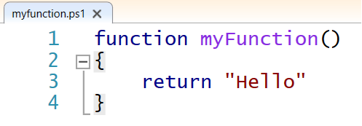
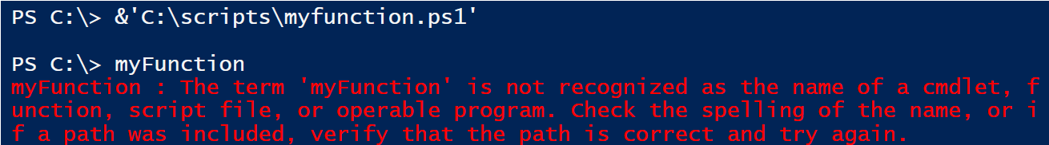
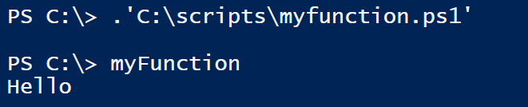
Examples
Run the script with &:
Dot source the script with . :

Slide 47
The execution policy
Get-ExecutionPolicy [-list]
Set-ExecutionPolicy
Restricted: No scripts can be run, PS can be used only in interactive mode
AllSigned: Only scripts signed by a trusted publisher can be run
RemoteSigned: Downloaded scripts must be signed by a trusted publisher
Unrestricted: No restrictions; all Windows PowerShell scripts can be run
Bypass: All scripts can be run, only possible on Process
On three different levels
Process: current PS-process
CurrentUser: current user
LocalMachine: all users of the computer
MachinePolicy
UserPolicy
Can be set without being an Administrator
Can only be set by Group Policy

Slide 48
Signing scripts
“Set-AuthenticodeSignature”
Which is nice, if you have a trusted root certificate
You can create one locally (self-signed), but that will only help you running scripts on your own computer
You can use the company-CA, and that would enable you to run all your scripts on all the company computers
You can get a commercial CA, and have your scripts available worldwide…

Slide 49
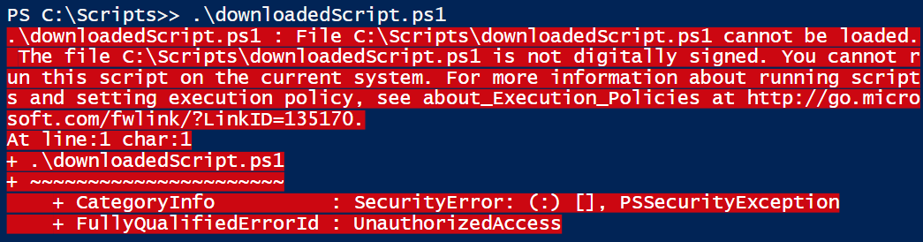
Is a script remote?
How does the computer distinguish between a downloaded script and a local script?
The problem:

Slide 50
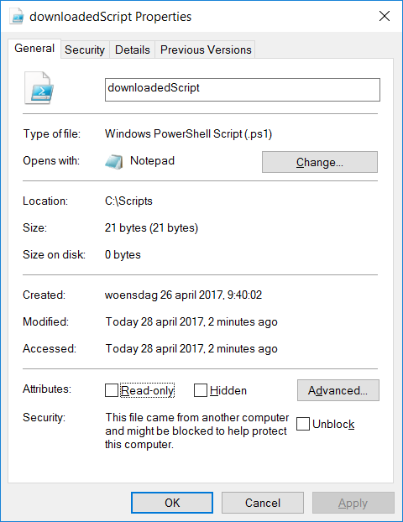
Is a script remote?
The reason (in a GUI):
Also the solution (in a GUI):
Or, the solution (in PS):
Unblock-File "downloadedScript.ps1"

Slide 51
Running a script
Doubleclick in Explorer
Default opens in notepad (fast!)
You can change this behaviour
Rightclick in Explorer – Edit (Bewerken)
Opens in ISE
Rightclick in Explorer – Run with PowerShell
Will always run with ByPass – execution policy
Start explicitly with Run
powershell.exe –noexit c:\scripts\test.ps1
powershell.exe –noexit &’c:\scripts\My script.ps1’
In Windows PowerShell console
A full path
A relative path with a dot first ( .\test.ps1 )
Only the name of the script if the path of the script is included in the path

Slide 52
Sudo su
It isn’t because your account is a member of the administrators, that every console you open uses these permissions (User Account Control)
Right click on PowerShell icon > run as administrator
In CLI (or ISE):
Start-Process PowerShell.exe –verb Runas
Runs a new CLI as Administrator
Only when the current user is a member of the administrators
Start-Process PowerShell.exe –verb Runasuser
To run as a different user
Start-Process PowerShell.exe –verb open
Simply open en new CLI (not elevated)
Start-Process PowerShell.exe -argumentlist nameScript
Executes one script in elevated mode
Start-Process powershell.exe -argumentlist "-executionpolicy bypass"
Start a new prompt with the executionpolicy bypassed

Slide 53
Errors: The classical way
try{
# code
5/0
}
catch [System.DivideByZeroException]{
"Catch System.DivideByZeroException exception"
# Use "Exit" to stop the script, without going to finally
# or other code behind the try/catch.
}
catch {
"Catch other exceptions"
}
finally {
"Always execute this code"
}

Slide 54
Errors: The new way
Trap traps any error in the script, not just the enclosed errors
In the trap-statement
Continue: continue with the script (default behavior)
Break: stop the script
$_: contains information on the error
You can add the specific type of error to catch ( [<exception type>] )
trap
{
"Error: $_"
"Error: " + $_.Exception.GetType().FullName
"Error: " + $_.Exception.Message
continue
}

Slide 55
Generating an error
Throw
Generates a terminating error in the script
Only used to stop a script immediately, not cleanly
Can be caught by trap and try-catch
vs. Write-Error
Generates a non-terminating error in the script
Will write an error to the default output (the screen, a logfile, …)
Can not be caught by trap and try-catch
Write-Error can cause a terminating error when the $ErrorActionPreference is set to "Stop"
Notes:
https://msdn.microsoft.com/en-us/powershell/reference/5.1/microsoft.powershell.core/about/about_throw

Slide 56
Parameters
When writing functions, you’ll probably need some parameters
For a quick and dirty function, simply put some variables
But even then, it’s good practice to choose describing names
You can refer to the variables in order
Or by name
function deduction($a, $b)
{
return $a - $b
}
deduction 7 5
deduction -b 5 -a 7

Slide 57
Strongly typed
If you know the datatype of the parameters, strongly type them
This will prevent errors in the function
(and create errors when calling the function)
function deduction([int] $a, [int] $b)
{
return $a - $b
}

Slide 58
Initialised parameter
A parameter that doesn’t have to passed to the function, but can be
Valid calls for the function:
function deduction([int] $a = 0, [int] $b = 10)
{
return $a - $b
}
deduction 7 5 # 7-5 = 2
deduction 7 # 7-10 = -3
deduction # 0-10 = -10
deduction -b 5 # 5-10 = -5

Slide 59
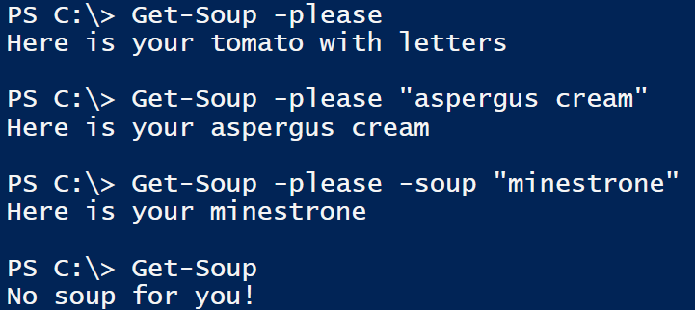
Switch parameter
A switch parameter can’t have a value, but can be present (or not)
Can be used as a Boolean variable in the function
Function Get-Soup ([switch]$please, [string]$soup="tomato with letters")
{
if ($please)
{
return "Here is your $soup"
}
else
{
return "No soup for you!"
}
}

Slide 60
Switch parameter
A switch is either present, or not present
This results in a $true or $false value
Making a switch default to $false is useless
A switch that is not present is always false
Making a switch default to $true is difficult
How would you turn the switch off, because if it’s not present, it will be true
Making a switch mandatory is also difficult
You force the use to have the switch, thereby turning it on
You can “forcibly turn off” a switch
By using a colon between the switch-name and the $false
Sometimes needed to turn of confirmation-screens
Get-Soup -please:$false

Slide 61
Bad practices
function deduction($a, $b)
{
$a - $b
}
Return values without using return
Works, but leads to the next bad practice
Return more than one value
How would the script calling this function process this value?
Impossible when using return because return ends the function
Writing from the function
Functions should silently do what they are supposed to, and not be to verbal about it
If we want to print what we are doing, the main script will
Ok to use: Write-Error and Write-Verbose
function deduction($a, $b)
{
"You're deducting"
$a - $b
}
function deduction($a, $b)
{
Write-Host "You're deducting"
return $a - $b
}

Slide 62
Requires
https://technet.microsoft.com/en-us/library/hh847765.aspx
#Requires can be used to require
Administrator-rights (-RunAsAdministrator)
A certain minimum version of PowerShell (-version 4.0)
An installed module (-module ActiveDirectory)
Can be used multiple times for different requirements

Slide 63

Get-ComputerSystem
A demo on how to write and fine-tune a script

Slide 64
What was in the demo
about_Functions_Advanced_Parameters
https://technet.microsoft.com/en-us/library/hh847743.aspx
about_Comment_Based_Help
https://technet.microsoft.com/en-us/library/hh847834.aspx

Slide 65
Summing up
In this presentation we talked about
What can be used in a script
How to ‘publish’ a script
If the script is strictly for personal use, you don’t have to go too deep into commenting and adding parameters
But you-two-years-from-now is a different person from you-now…
This and the previous presentation combined give you an insight into how PowerShell works
Next up is diving deeper into certain topics (ActiveDirectory, NTFS, …)
But the basic principals remain…

